Slide 1
PREDICT 422: Practical Machine Learning
Module 4:
Linear Model Selection and Regularization
Lecturer: Nathan Bastian, Section: XXX

Slide 2
Assignment
Reading: Ch. 6
Activity: Quiz 4, R Lab 4

Slide 3
References
An Introduction to Statistical Learning, with Applications in R (2013), by G. James, D. Witten, T. Hastie, and R. Tibshirani.
The Elements of Statistical Learning (2009), by T. Hastie, R. Tibshirani, and J. Friedman.
Learning from Data: A Short Course (2012), by Y. Abu-Mostafa, M. Magdon-Ismail, and H. Lin.
Machine Learning: A Probabilistic Perspective (2012), by K. Murphy.

Slide 4
Lesson Goals:
Understand best subset selection and stepwise selection methods for reducing the number of predictor variables in regression.
Indirectly estimate test error by adjusting training error to account for bias due to overfitting (C_{p}, AIC, BIC, adjusted R²).
Directly estimate test error using validation set approach and cross-validation approach.
Understand and know how to perform ridge regression and the lasso as shrinkage (regularization) methods.
Understand and know how to perform principal components regression and partial least squares as dimension reduction methods.
Learn considerations for high-dimensional settings.

Slide 5
Improving the Linear Model
We may want to improve the simple linear model by replacing OLS estimation with some alternative fitting procedure.
Why use an alternative fitting procedure?
Prediction Accuracy
Model Interpretability

Slide 6
Prediction Accuracy
The OLS estimates have relatively low bias and low variability especially when the relationship between the response and predictors is linear and n >> p.
If n is not much larger than p, then the OLS fit can have high variance and may result in over fitting and poor estimates on unseen observations.
If p > n, then the variability of the OLS fit increases dramatically, and the variance of these estimates in infinite.

Slide 7
Model Interpretability
When we have a large number of predictors in the model, there will generally be many that have little or no effect on the response.
Including such irrelevant variable leads to unnecessary complexity.
Leaving these variables in the model makes it harder to see the effect of the important variables.
The model would be easier to interpret by removing (i.e. setting the coefficients to zero) the unimportant variables.

Slide 8
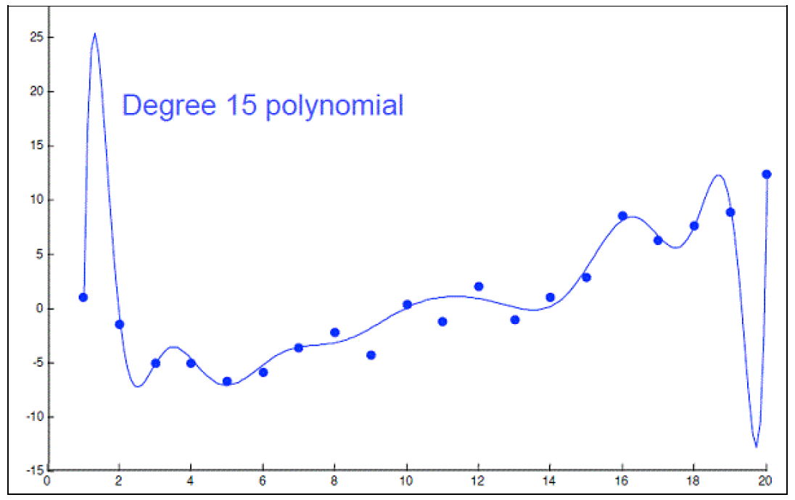
Feature/Variable Selection
Carefully selected features can improve model accuracy, but adding too many can lead to overfitting.
Overfitted models describe random error or noise instead of any underlying relationship.
They generally have poor predictive performance on test data.
For instance, we can use a 15-degree polynomial function to fit the following data so that the fitted curve goes nicely through the data points.
However, a brand new dataset collected from the same population may not fit this particular curve well at all.

Slide 9
Feature/Variable Selection (cont.)
Subset Selection
Identify a subset of the p predictors that we believe to be related to the response; then, fit a model using OLS on the reduced set.
Methods: best subset selection, stepwise selection
Shrinkage (Regularization)
Involves shrinking the estimated coefficients toward zero relative to the OLS estimates; has the effect of reducing variance and performs variable selection.
Methods: ridge regression, lasso
Dimension Reduction
Involves projecting the p predictors into a M-dimensional subspace, where M < p, and fit the linear regression model using the M projections as predictors.
Methods: principal components regression, partial least squares

Slide 10
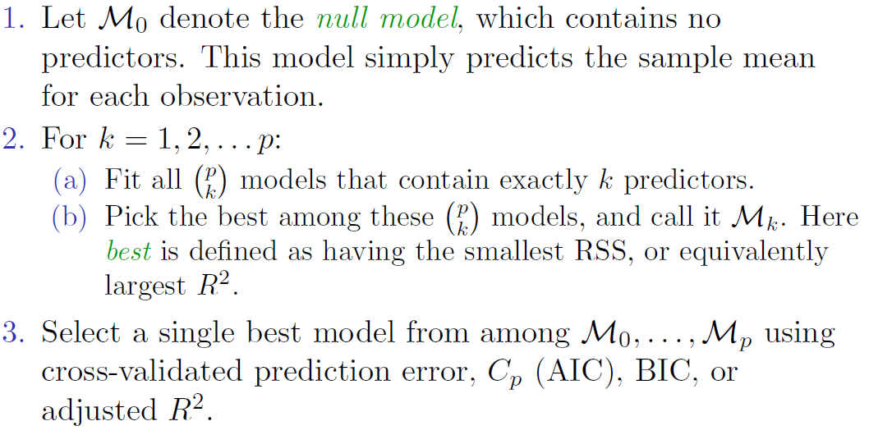
Best Subset Selection
We fit a separate OLS regression for each possible combination of the p predictors:

Slide 11
Best Subset Selection (cont.)
The RSS (R²) will always decline (increase) as the number of predictors included in the model increases, so they are not very useful statistics for selecting the best model.
The red line tracks the best model for a given number of predictors, according to RSS and R²

Slide 12
Best Subset Selection (cont.)
While best subset selection is a simple and conceptually appealing approach, it suffers from computational limitations.
The number of possible models that must be considered grows rapidly as p increases.
Best subset selection becomes computationally infeasible for value of p greater than around 40.

Slide 13
Stepwise Selection
For computational reasons, best subset selection cannot be applied with very large p.
The larger the search space, the higher the chance of finding models that look good on the training data, even though they might not have any predictive power on future data.
An enormous search space can lead to overfitting and high variance of the coefficient estimates.

Slide 14
Stepwise Selection (cont.)
More attractive methods include:
Forward Stepwise Selection
Begins with a null OLS model containing no predictors, and then adds one predictor at a time that improves the model the most until no further improvement is possible.
Backward Stepwise Selection
Begins with a full OLS model containing all predictors, and then deletes one predictor at a time that improves the model the most until no further improvement is possible.

Slide 15
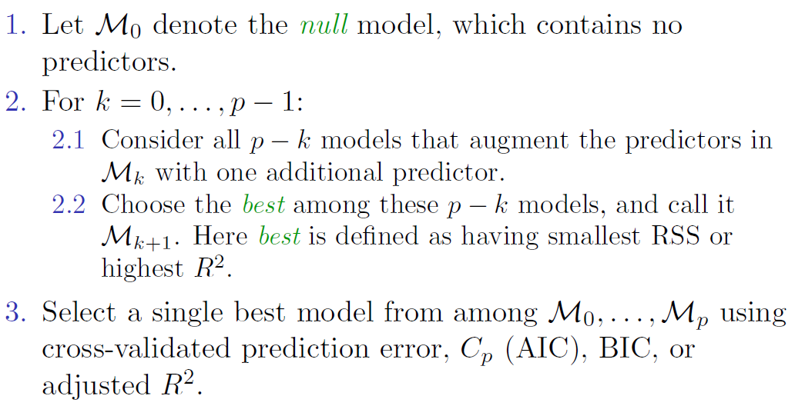
Forward Stepwise Selection

Slide 16
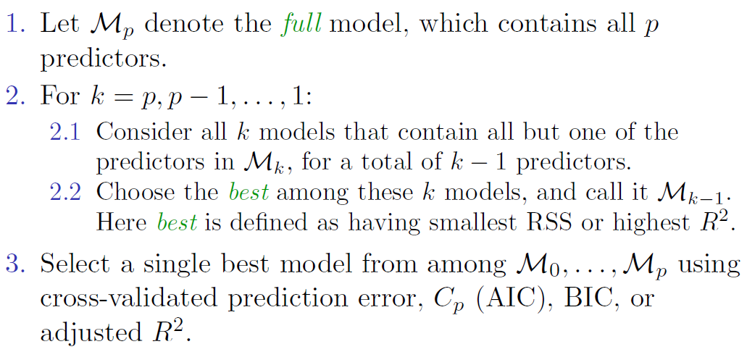
Backward Stepwise Selection

Slide 17
Stepwise Selection (cont.)
Both forward and backward stepwise selection approaches search through only 1 + p(p + 1)/2 models, so they can be applied in settings where p is too large to apply best subset selection.
Both of these stepwise selection methods are not guaranteed to yield the best model containing a subset of the p predictors.
Forward stepwise selection can be used even when n < p, while backward stepwise selection requires that n > p.
There is a hybrid version of these two stepwise selection methods.

Slide 18
Choosing the Optimal Model
The model containing all the predictors will always have the smallest RSS and the largest R², since these quantities are related to the training error.
We wish to choose a model with low test error, not a model with low training error. Recall that training error is usually a poor estimate of test error.
Thus, RSS and R² are not suitable for selecting the best model among a collection of models with different numbers of predictors.

Slide 19
Estimating Test Error
We can indirectly estimate test error by making an adjustment to the training error to account for the bias due to overfitting.
We can directly estimate the test error, using either a validation set approach or a cross-validation approach.

Slide 20
Other Measures of Comparison
To compare different models, we can use other approaches:
Adjusted R²
AIC (Akaike information criterion)
BIC (Bayesian information criterion)
Mallow’s C_{p} (equivalent to AIC for linear regression)
These techniques adjust the training error for the model size, and can be used to select among a set of models with different numbers of variables.
These methods add penalty to RSS for the number of predictors in the model.

Slide 21
Credit Data: C_{p}, BIC, and Adjusted R²
A small value of C_{p} and BIC indicates a low error, and thus a better model.
A large value for the Adjusted R² indicates a better model.

Slide 22
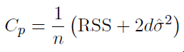
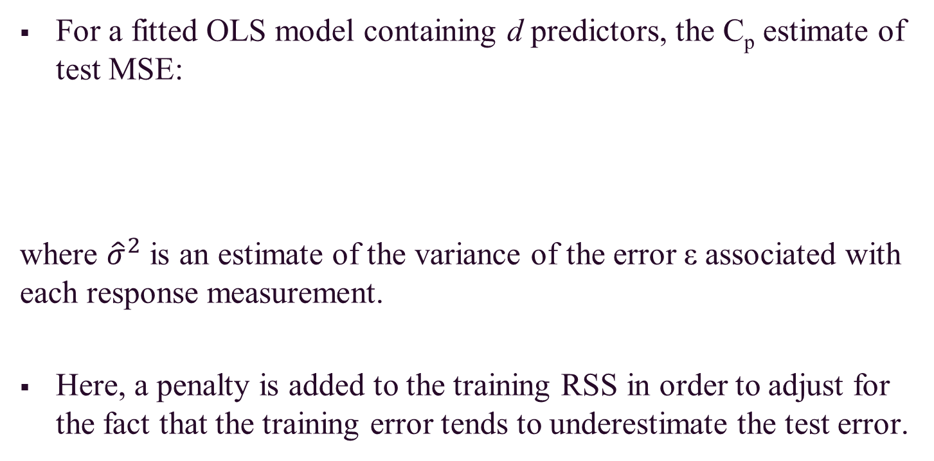
Mallow’s C_{p}
For a fitted OLS model containing d predictors, the C_{p} estimate of test MSE:
where ${\hat{σ}}^{2}$ is an estimate of the variance of the error ε associated with each response measurement.
Here, a penalty is added to the training RSS in order to adjust for the fact that the training error tends to underestimate the test error.

Slide 23
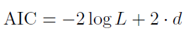
Akaike Information Criterion (AIC)
Defined for a large class of models fit by maximum likelihood.
where L is the maximized value of the likelihood function for the estimated model.
In the case of the linear model with Gaussian errors, MLE and OLS are the same things; thus, C_{p} and AIC are equivalent.

Slide 24
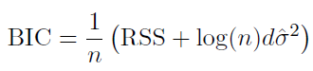
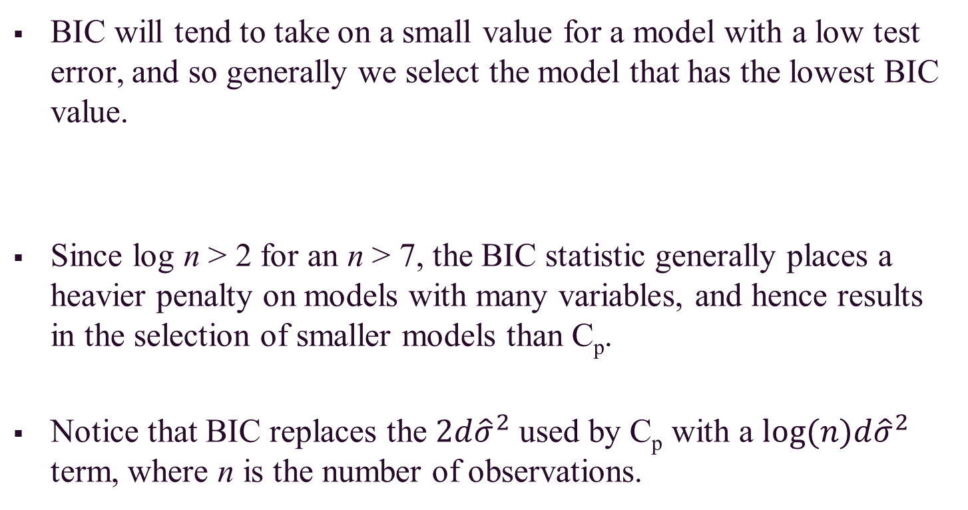
Bayesian Information Criterion (BIC)
BIC will tend to take on a small value for a model with a low test error, and so generally we select the model that has the lowest BIC value.
Since log n > 2 for an n > 7, the BIC statistic generally places a heavier penalty on models with many variables, and hence results in the selection of smaller models than C_{p}.
Notice that BIC replaces the ${2d\hat{σ}}^{2}$ used by C_{p} with a ${log⁡(n)d\hat{σ}}^{2}$ term, where n is the number of observations.

Slide 25
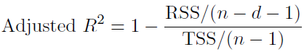
Adjusted R²
For an OLS model with d variables, the adjusted R² is calculated:
where TSS is the total sum of squares.
Unlike the other statistics, a large value of adjusted R² indicates a model with a small test error.
The adjusted R² statistics pays a price for the inclusion of unnecessary variables in the model.

Slide 26
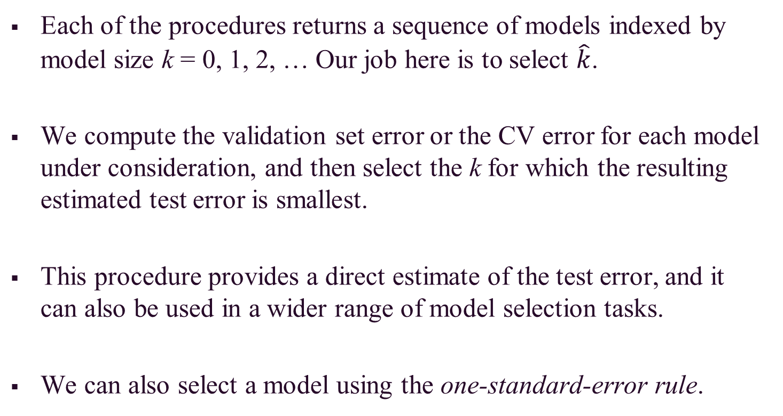
Validation and Cross-Validation
Each of the procedures returns a sequence of models indexed by model size k = 0, 1, 2, … Our job here is to select $\hat{k}$.
We compute the validation set error or the CV error for each model under consideration, and then select the k for which the resulting estimated test error is smallest.
This procedure provides a direct estimate of the test error, and it can also be used in a wider range of model selection tasks.
We can also select a model using the one-standard-error rule.

Slide 27
Shrinkage (Regularization) Methods
The subset selection methods use OLS to fit a linear model that contains a subset of the predictors.
As an alternative, we can fit a model containing all p predictors using a technique that constrains or regularizes the coefficient estimates (i.e. shrinks the coefficient estimates towards zero).
It may not be immediately obvious why such a constraint should improve the fit, but it turns out that shrinking the coefficient estimates can significantly reduce their variance.

Slide 28
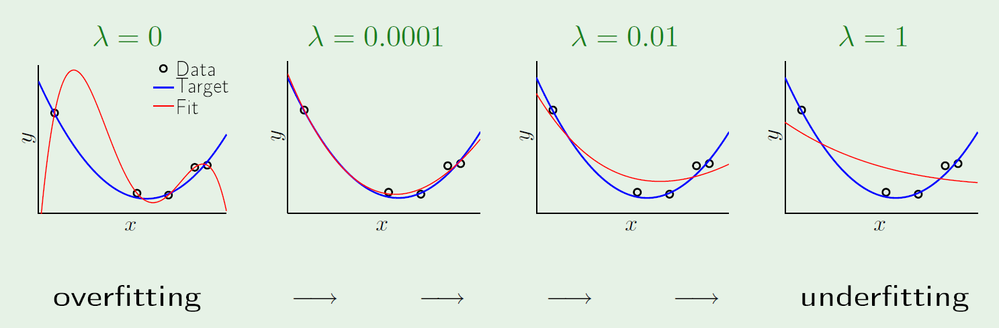
Shrinkage (Regularization) Methods (cont.)
Regularization is our first weapon to combat overfitting.
It constrains the machine learning algorithm to improve out-of-sample error, especially when noise is present.
Look at what a little regularization can do:

Slide 29
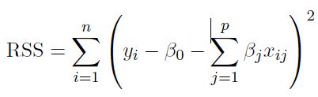
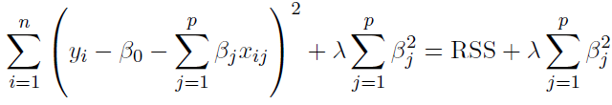
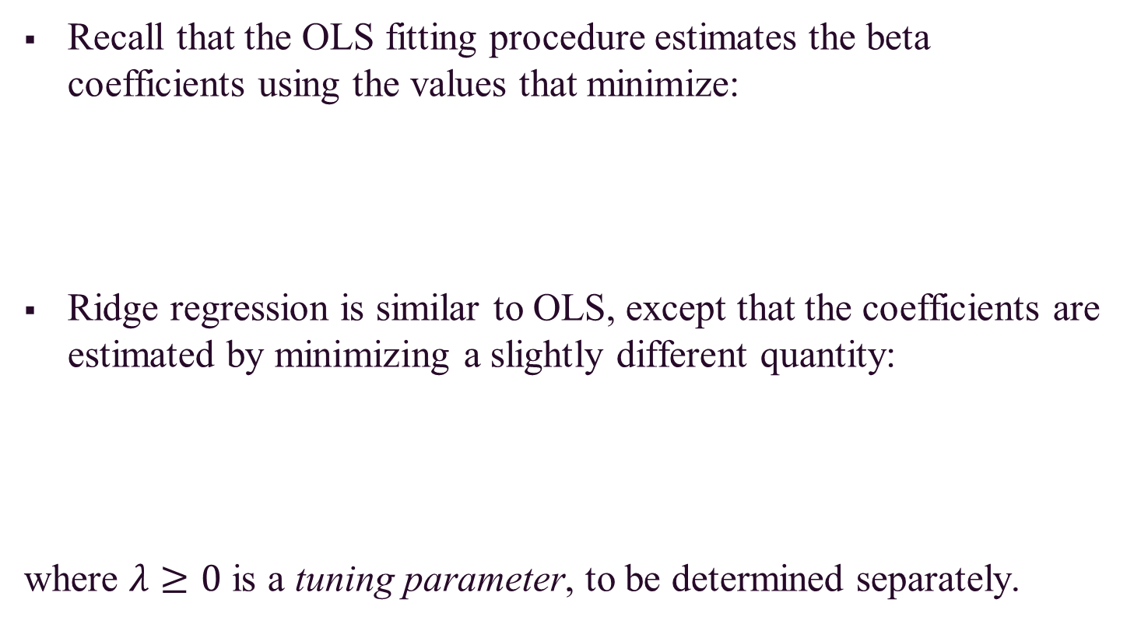
Ridge Regression
Recall that the OLS fitting procedure estimates the beta coefficients using the values that minimize:
Ridge regression is similar to OLS, except that the coefficients are estimated by minimizing a slightly different quantity:
where $λ≥0$ is a tuning parameter, to be determined separately.

Slide 30
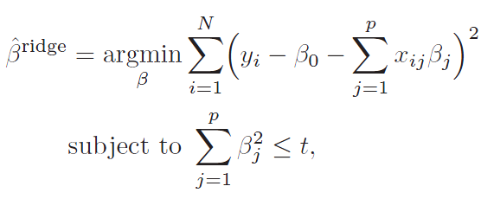
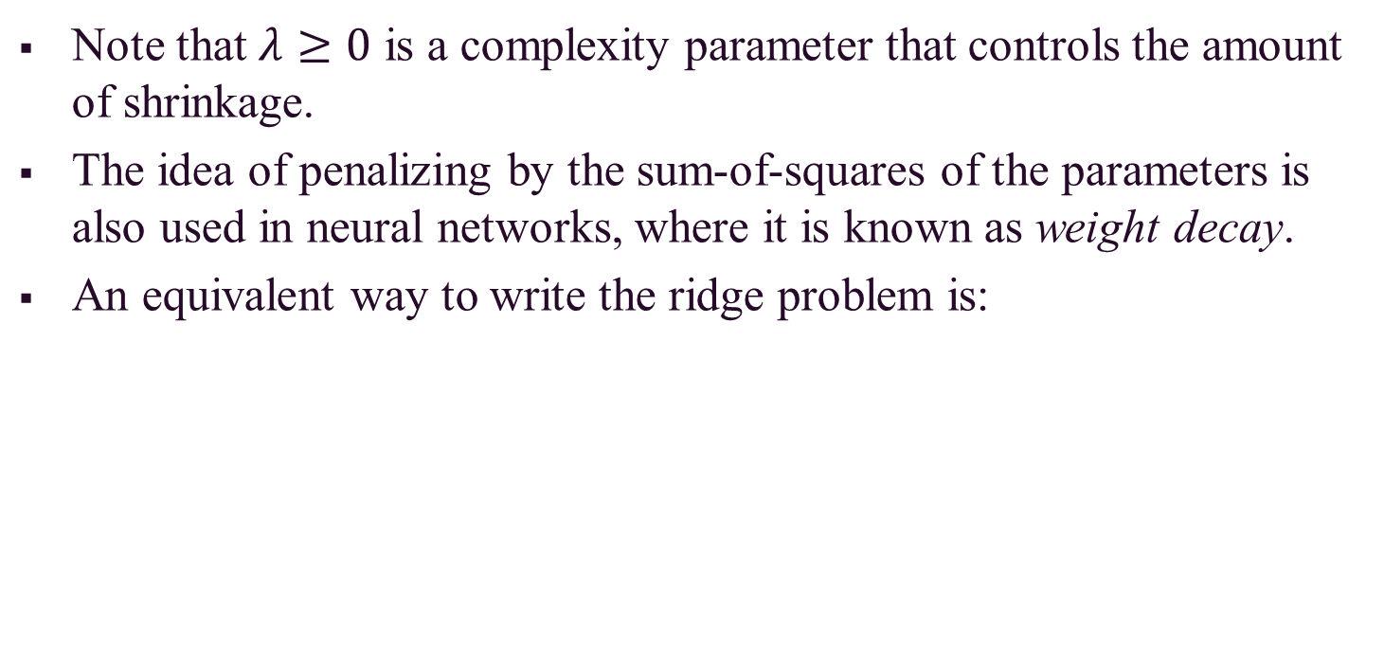
Ridge Regression (cont.)
Note that $λ≥0$ is a complexity parameter that controls the amount of shrinkage.
The idea of penalizing by the sum-of-squares of the parameters is also used in neural networks, where it is known as weight decay.
An equivalent way to write the ridge problem is:

Slide 31
Ridge Regression (cont.)
The effect of this equation is to add a shrinkage penalty of the form
where the tuning parameter λ is a positive value.
This has the effect of shrinking the estimated beta coefficients towards zero. It turns out that such a constraint should improve the fit, because shrinking the coefficients can significantly reduce their variance.
Note that when λ = 0, the penalty term as no effect, and ridge regression will procedure the OLS estimates. Thus, selecting a good value for λ is critical (can use cross-validation for this).

Slide 32
Ridge Regression (cont.)
As λ increases, the standardized ridge regression coefficients shrinks towards zero.
Thus, when λ is extremely large, then all of the ridge coefficient estimates are basically zero; this corresponds to the null model that contains no predictors.

Slide 33
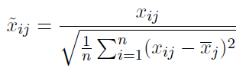
Ridge Regression (cont.)
The standard OLS coefficient estimates are scale equivariant.
However, the ridge regression coefficient estimates can change substantially when multiplying a given predictor by a constant, due to the sum of squared coefficients term in the penalty part of the ridge regression objective function.
Thus, it is best to apply ridge regression after standardizing the predictors:

Slide 34
Ridge Regression (cont.)
It turns out that the OLS estimates generally have low bias but can be highly variable. In particular when n and p are of similar size or when n < p, then the OLS estimates will be extremely variable
The penalty term makes the ridge regression estimates biased but can also substantially reduce variance
As a result, there is a bias/variance trade-off.

Slide 35
Ridge Regression (cont.)
Black = Bias
Green = Variance
Purple = MSE
Increased λ leads to increased bias but decreased variance

Slide 36
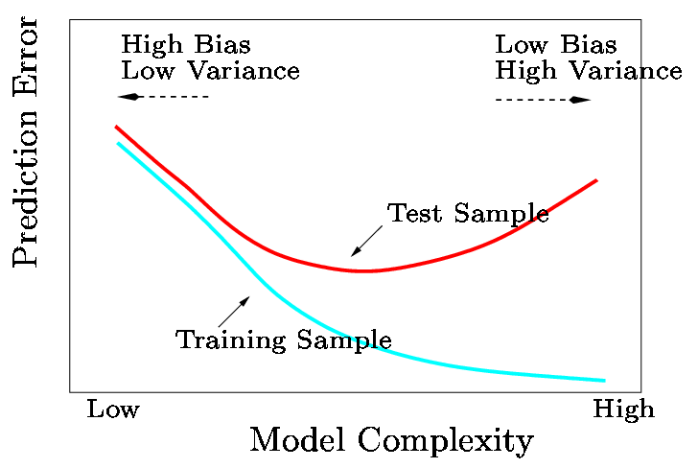
Ridge Regression (cont.)
In general, the ridge regression estimates will be more biased than the OLS ones but have lower variance.
Ridge regression will work best in situations where the OLS estimates have high variance.

Slide 37
Ridge Regression (cont.)
Computational Advantages of Ridge Regression
If p is large, then using the best subset selection approach requires searching through enormous numbers of possible models.
With ridge regression, for any given λ we only need to fit one model and the computations turn out to be very simple.
Ridge regression can even be used when p > n, a situation where OLS fails completely (i.e. OLS estimates do not even have a unique solution).

Slide 38
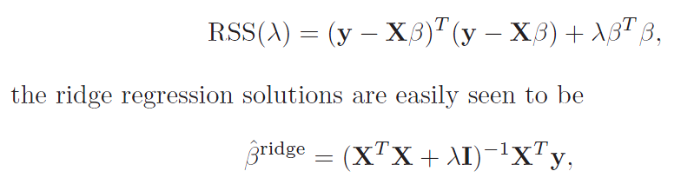
Ridge Regression (cont.)
In matrix form:
The solution adds a positive constant to the diagonal of X^{T}X before inversion (making the problem non-singular).
The singular value decomposition (SVD) of the centered matrix X gives us some additional insight into the nature of ridge regression.

Slide 39
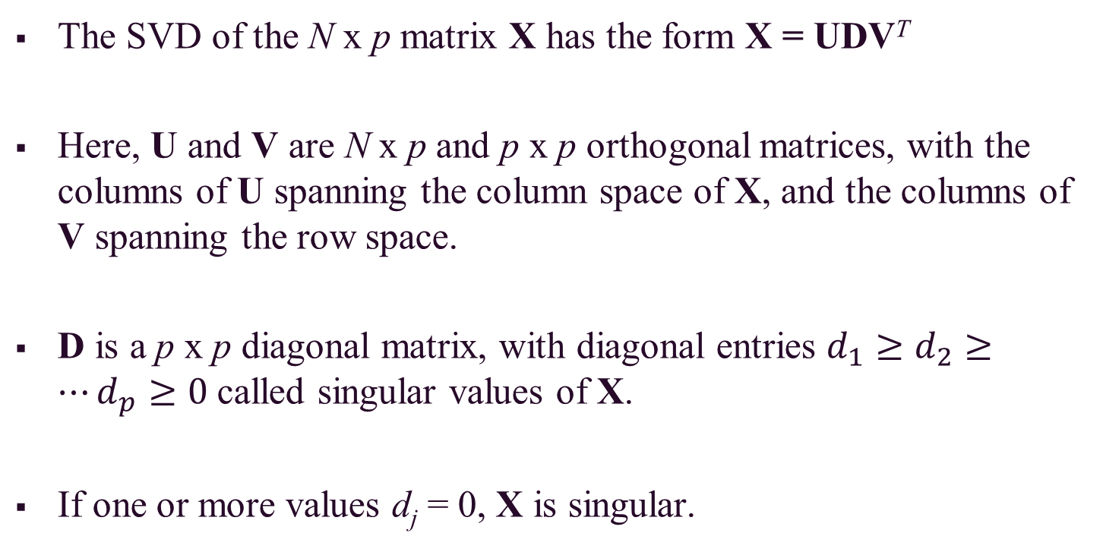
Ridge Regression (cont.)
The SVD of the N x p matrix X has the form X = UDV^{T}
Here, U and V are N x p and p x p orthogonal matrices, with the columns of U spanning the column space of X, and the columns of V spanning the row space.
D is a p x p diagonal matrix, with diagonal entries $d_{1}≥d_{2}≥…d_{p}≥0$ called singular values of X.
If one or more values d_{j} = 0, X is singular.

Slide 40
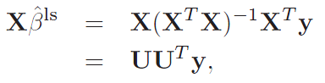
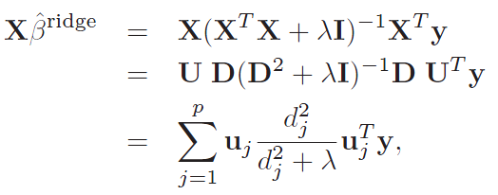
Ridge Regression (cont.)
Using SVD, we can write the OLS fitted vector as:
The ridge regression solutions are:
where u_{j} are the columns of U.

Slide 41
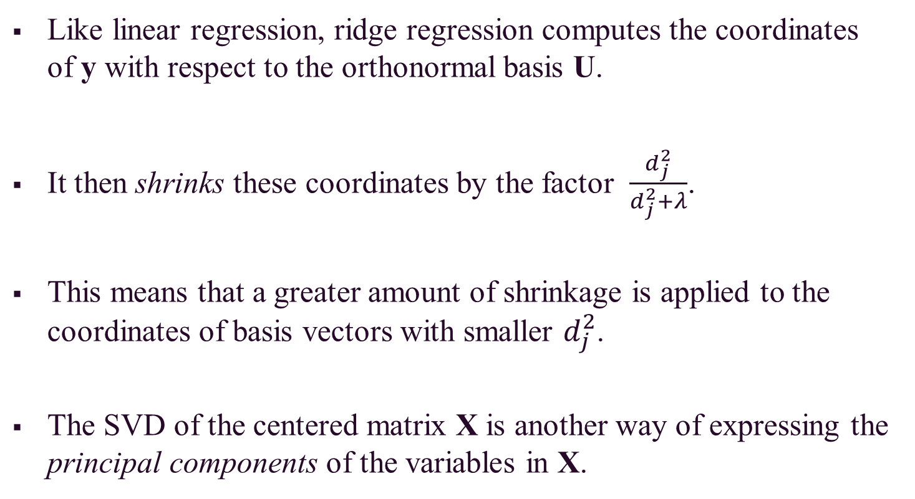
Ridge Regression (cont.)
Like linear regression, ridge regression computes the coordinates of y with respect to the orthonormal basis U.
It then shrinks these coordinates by the factor $\frac{d_{j}^{2}}{d_{j}^{2}+λ}$.
This means that a greater amount of shrinkage is applied to the coordinates of basis vectors with smaller $d_{j}^{2}$.
The SVD of the centered matrix X is another way of expressing the principal components of the variables in X.

Slide 42
Ridge Regression (cont.)
Thus, we have X^{T}X = VD²V^{T}, which is the eigen decomposition of X^{T}X.
The eigenvectors v_{j} (columns of V) are also called the principal components directions of X.
The first principal component direction v₁ has the property that z1 = Xv₁ has the largest sample variance amongst all normalized linear combinations of the columns of X.
The small singular values d_{j} correspond to directions in the column space of X having small variance, and ridge regression shrinks these directions the most.

Slide 43
The Lasso
One significant problem of ridge regression is that the penalty term will never force any of the coefficients to be exactly zero.
Thus, the final model will include all p predictors, which creates a challenge in model interpretation
A more modern machine learning alternative is the lasso.
The lasso works in a similar way to ridge regression, except it uses a different penalty term that shrinks some of the coefficients exactly to zero.

Slide 44
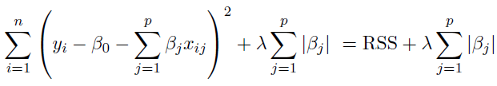
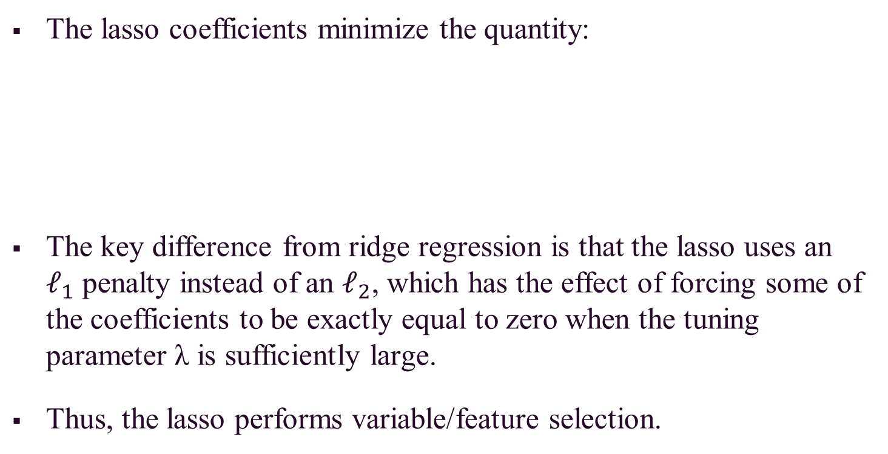
The Lasso (cont.)
The lasso coefficients minimize the quantity:
The key difference from ridge regression is that the lasso uses an $ℓ_{1}$ penalty instead of an $ℓ_{2}$, which has the effect of forcing some of the coefficients to be exactly equal to zero when the tuning parameter λ is sufficiently large.
Thus, the lasso performs variable/feature selection.

Slide 45
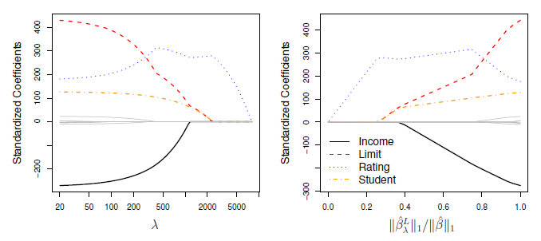
The Lasso (cont.)
When λ = 0, then the lasso simply gives the OLS fit.
When λ becomes sufficiently large, the lasso gives the null model in which all coefficient estimates equal zero.

Slide 46
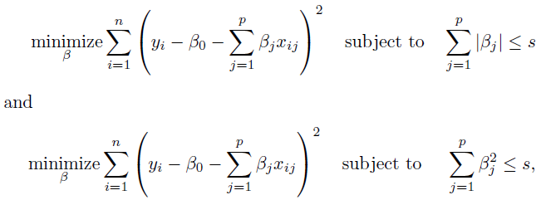
The Lasso (cont.)
One can show that the lasso and ridge regression coefficient estimates solves the problems:

Slide 47
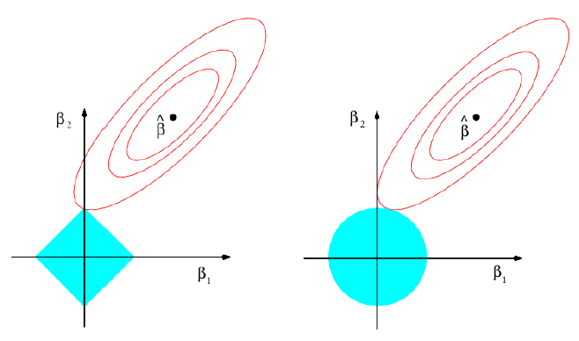
The Lasso (cont.)
The lasso and ridge regression coefficient estimates are given by the first point at which an ellipse contacts the constraint region.
OLS Solution
Ridge Regression
Lasso

Slide 48
Lasso vs. Ridge Regression
The lasso has a major advantage over ridge regression, in that it produces simpler and more interpretable models that involved only a subset of predictors.
The lasso leads to qualitatively similar behavior to ridge regression, in that as λ increases, the variance decreases and the bias increases.
The lasso can generate more accurate predictions compared to ridge regression.
Cross-validation can be used in order to determine which approach is better on a particular data set.

Slide 49
Selecting the Tuning Parameter λ
As for subset selection, for ridge regression and lasso we require a method to determine which of the models under consideration in best; thus, we required a method selecting a value for the tuning parameter λ or equivalently, the value of the constraint s.
Select a grid of potential values; use cross-validation to estimate the error rate on test data (for each value of λ) and select the value that gives the smallest error rate.
Finally, the model is re-fit using all of the variable observations and the selected value of the tuning parameter λ.

Slide 50
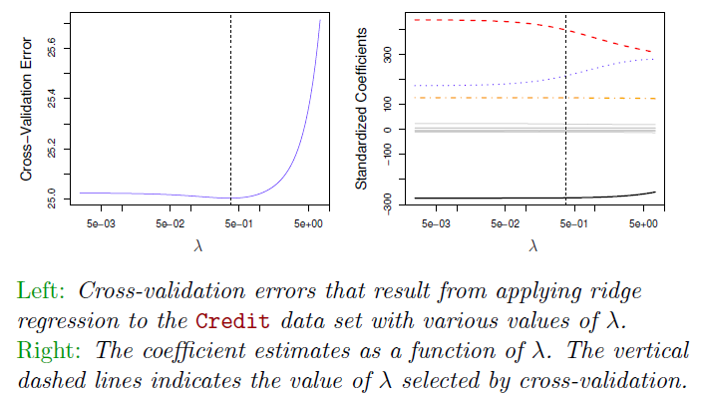
Selecting the Tuning Parameter λ: Credit Data Example

Slide 51
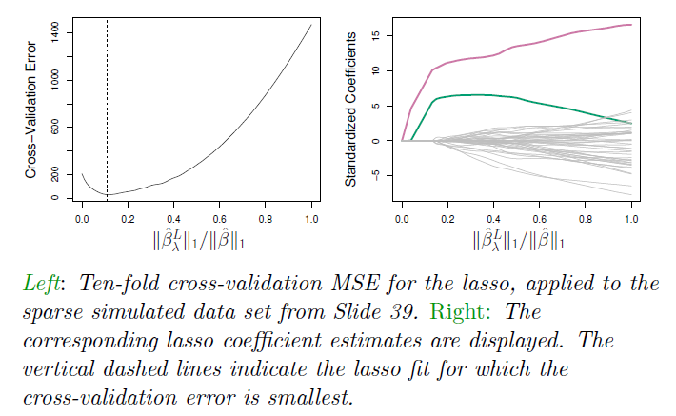
Selecting the Tuning Parameter λ: Simulated Data Example

Slide 52
Dimension Reduction
The methods we have discussed so far have involved fitting linear regression models, via OLS or a shrunken approach, using the original predictors.
We now explore a class of approaches that transform the predictors and then fit an OLS model using the transformed variables.
We refer to these techniques as dimension reduction methods.

Slide 53
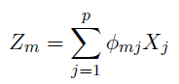
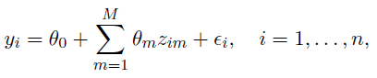
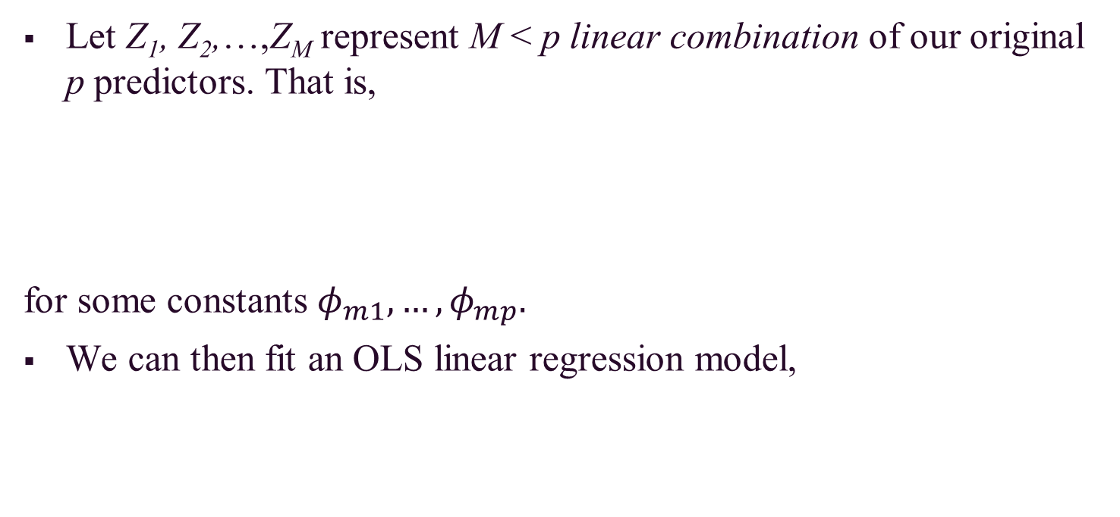
Dimension Reduction (cont.)
Let Z₁, Z₂,…,Z_{M} represent M < p linear combination of our original p predictors. That is,
for some constants $φ_{m1}, …,φ_{mp}.$
We can then fit an OLS linear regression model,

Slide 54
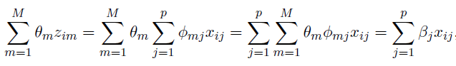
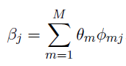
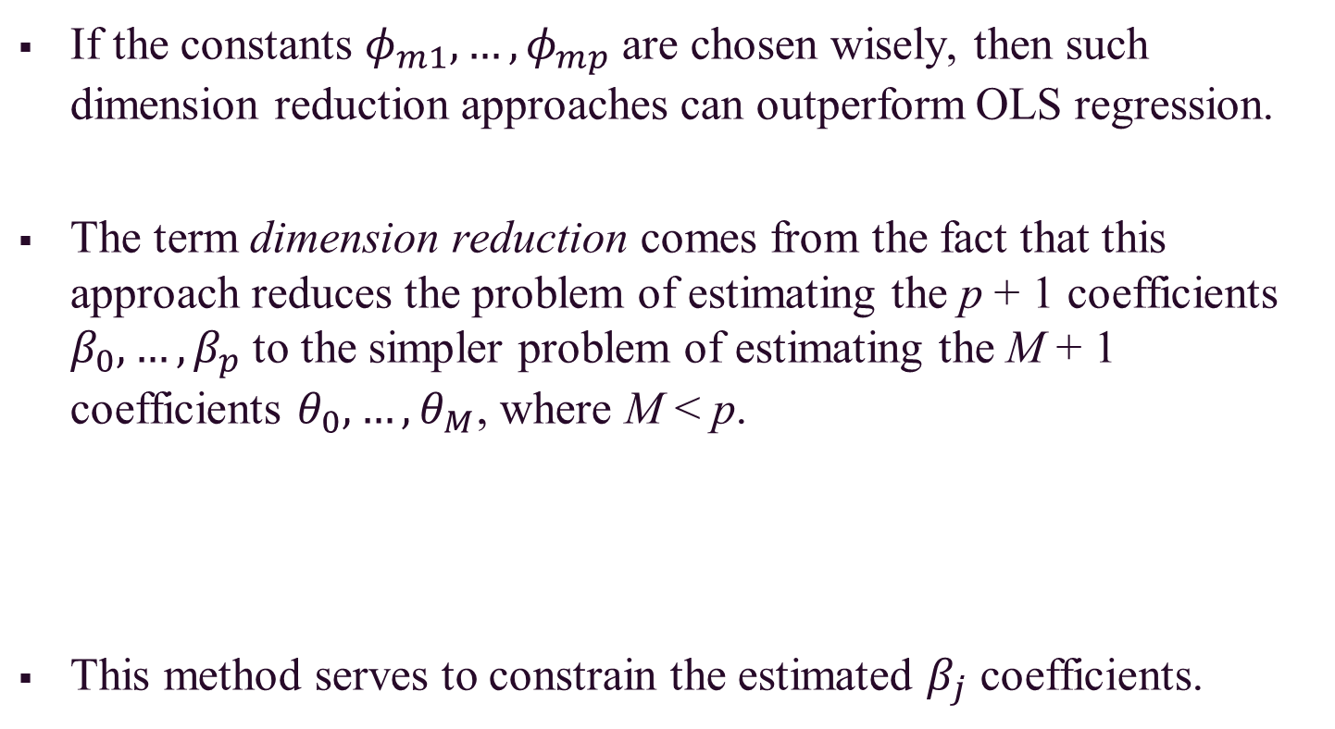
Dimension Reduction (cont.)
If the constants $φ_{m1}, …,φ_{mp}$ are chosen wisely, then such dimension reduction approaches can outperform OLS regression.
The term dimension reduction comes from the fact that this approach reduces the problem of estimating the p + 1 coefficients $β_{0}, …,β_{p}$ to the simpler problem of estimating the M + 1 coefficients $θ_{0}, …,θ_{M}$, where M < p.
This method serves to constrain the estimated $β_{j}$ coefficients.

Slide 55
Principal Components Regression
Here, we apply principal components analysis (PCA) to define the linear combinations of the predictors, for use in the regression.
The first principal component is that (normalized) linear combination of the variables with the largest variances.
The second principal component has largest variance, subject to being uncorrelated with the first….etc.
Thus, with many correlated variables, we replace them with a small set of principal components that capture their joint variation.

Slide 56
Principal Components Regression (cont.)
The principal components regression (PCR) approach involves constructing the first M principal components, and then using these components as the predictors in an OLS linear regression model.
The key idea is that often a small number of principal components suffice to explain most of the variability in the data, as well as the relationship with the response.
We assume that the directions in which X₁,…,X_{p} show the most variation are the directions that are associated with Y.
When performing PCR, predictors should be standardized prior to generating the principal components.

Slide 57
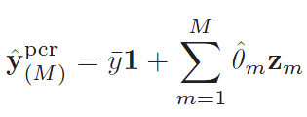
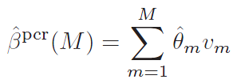
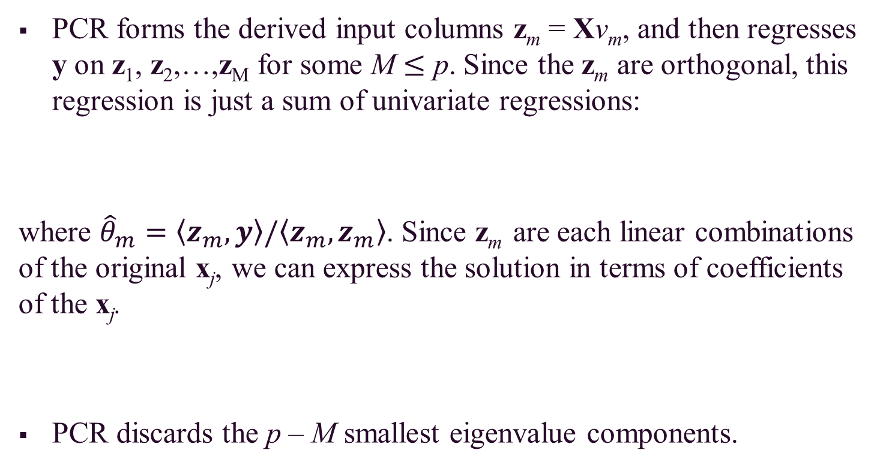
Principal Components Regression (cont.)
PCR forms the derived input columns z_{m} = Xv_{m}, and then regresses y on z₁, z₂,…,z_{M} for some M $≤$ p. Since the z_{m} are orthogonal, this regression is just a sum of univariate regressions:
where ${\hat{θ}}_{m}=\left\langle z_{m},y\right\rangle /\left\langle z_{m},z_{m}\right\rangle$. Since z_{m} are each linear combinations of the original x_{j}, we can express the solution in terms of coefficients of the x_{j}.
PCR discards the p – M smallest eigenvalue components.

Slide 58
Principal Components Regression (cont.)
By manually setting the projection onto the principal component directions with small eigenvalues set to 0 (i.e., only keeping the large ones), dimension reduction is achieved.
PCR is very similar to ridge regression in a certain sense.
Ridge regression can be viewed conceptually as projecting the y vector onto the principal component directions and then shrinking the projection on each principal component direction.

Slide 59
Principal Components Regression (cont.)
The amount of shrinkage depends on the variance of that principal component.
Ridge regression shrinks everything, but it never shrinks anything to zero.
By contrast, PCR either does not shrink a component at all or shrinks it to zero.

Slide 60
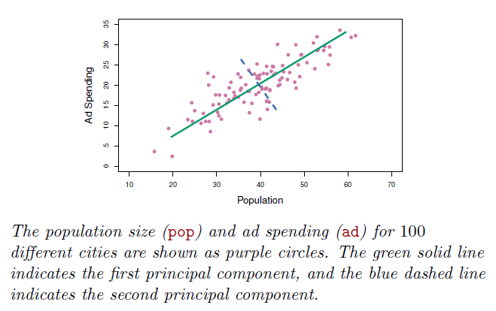
Principal Components Regression (cont.)

Slide 61
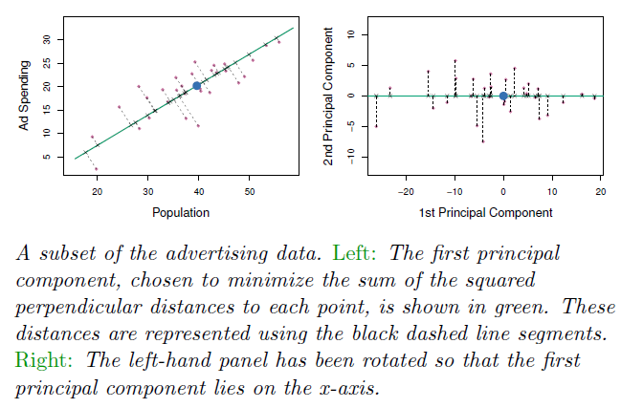
Principal Components Regression (cont.)

Slide 62
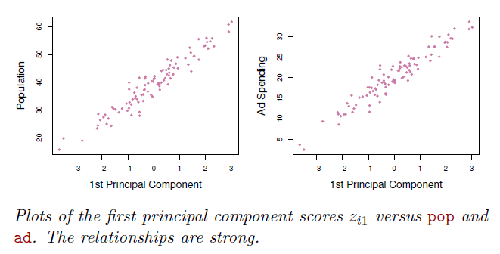
Principal Components Regression (cont.)

Slide 63
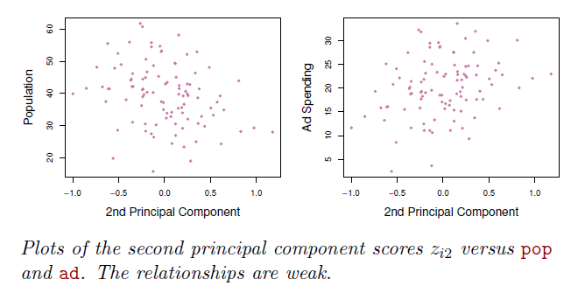
Principal Components Regression (cont.)

Slide 64
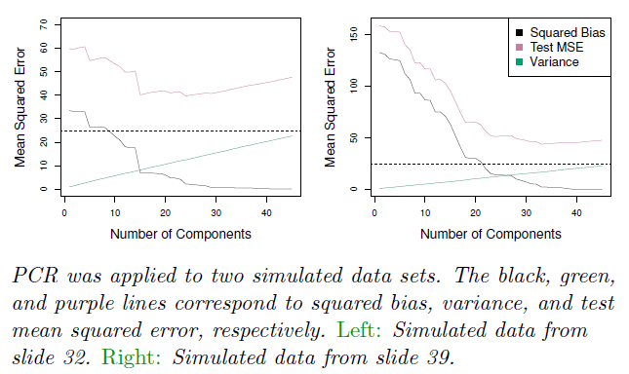
Principal Components Regression (cont.)

Slide 65
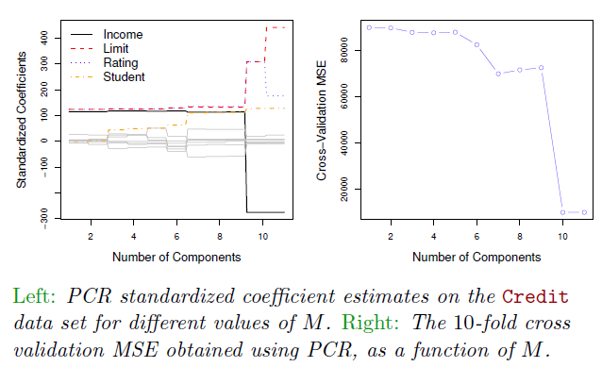
Principal Components Regression (cont.)

Slide 66
Principal Components Regression (cont.)
As more principal components are used in the regression model, the bias decreases but the variance increases.
PCR will tend to do well in cases when the first few principal components are sufficient to capture most of the variation in the predictors as well as the relationship with the response.
We note that even though PCR provides a simple way to perform regression using M < p predictors, it is not a feature selection method.
In PCR, the number of principal components is typically chosen by cross-validation.

Slide 67
Partial Least Squares
PCR identifies linear combinations, or directions, that best represents the predictors.
These directions are identified is an unsupervised way, since the response Y is not used to help determine the principal component directions.
That is, the response does not supervise the identification of the principal components.
PCR suffers from a potentially serious drawback: there is no guarantee that the directions that best explain the predictors will also be the best directions to use for predicting the response.

Slide 68
Partial Least Squares (cont.)
Like PCR, partial least squares (PLS) is a dimension reduction method, which first identifies a new set of features Z₁,…,Z_{M} that are linear combinations of the original features.
Then PLS fits an OLS linear model using these M new features.
Unlike PCR, PLS identifies these new features in a supervised way; PLS makes use of the response Y in order to identify new features that not only approximate the old features well, but also that are related to the response.
The PLS approach attempts to find directions that help explain both the response and the predictors.

Slide 69
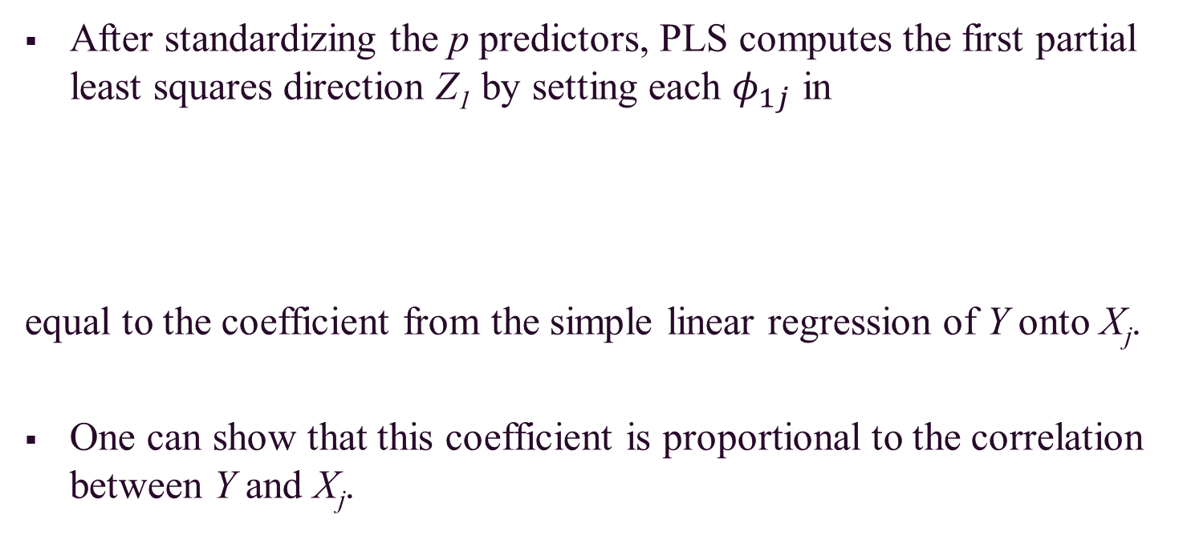
Partial Least Squares (cont.)
After standardizing the p predictors, PLS computes the first partial least squares direction Z₁ by setting each $φ_{1j}$ in
equal to the coefficient from the simple linear regression of Y onto X_{j}.
One can show that this coefficient is proportional to the correlation between Y and X_{j}.

Slide 70
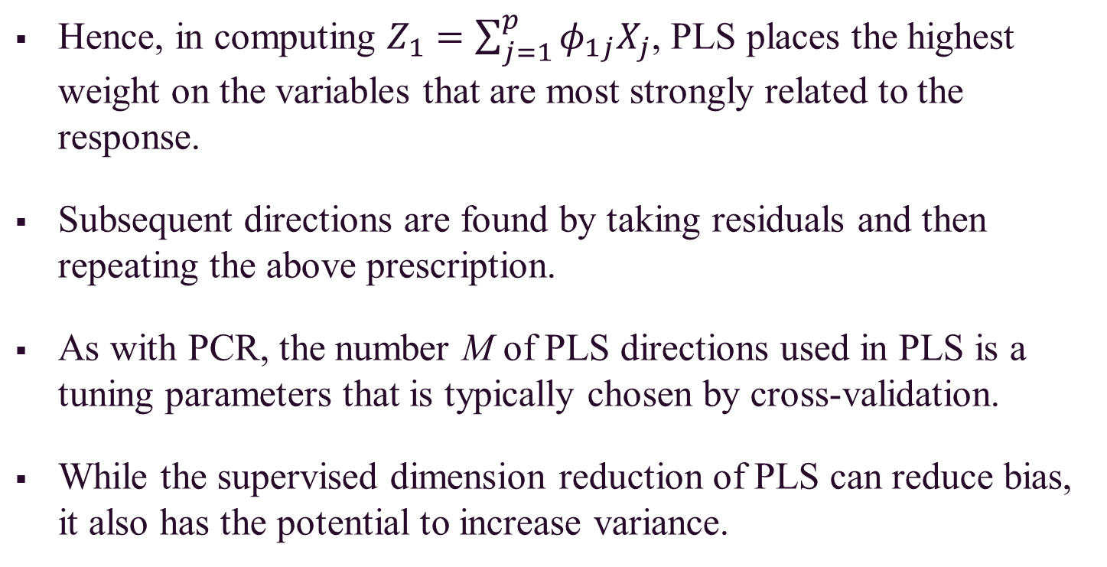
Partial Least Squares (cont.)
Hence, in computing $Z_{1}=\sum_{j=1}^{p}{φ_{1j}X_{j}}$, PLS places the highest weight on the variables that are most strongly related to the response.
Subsequent directions are found by taking residuals and then repeating the above prescription.
As with PCR, the number M of PLS directions used in PLS is a tuning parameters that is typically chosen by cross-validation.
While the supervised dimension reduction of PLS can reduce bias, it also has the potential to increase variance.

Slide 71
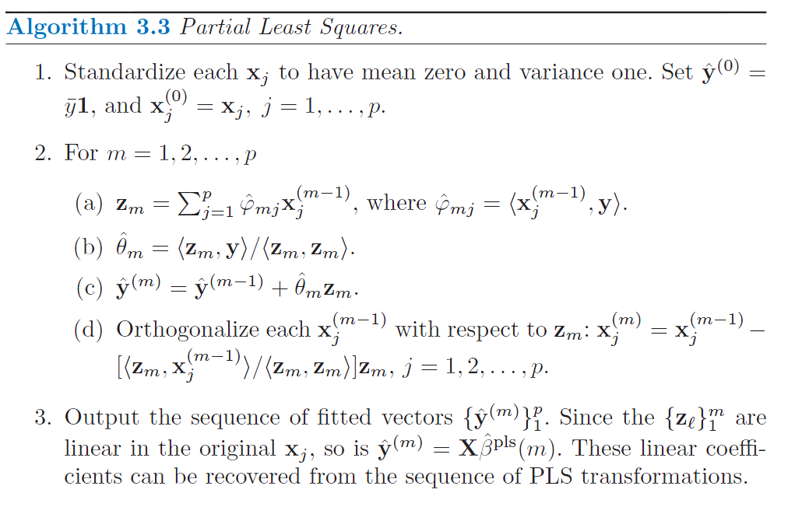
Partial Least Squares (cont.)

Slide 72
Considerations in High Dimensions
While p can be extremely large, the number of observations n is often limited due to cost, sample availability, etc.
Data sets containing more features than observations are often referred to a high-dimensional.
When the number of features p is as large as, or larger than, the number of observations n, OLS should not be performed.
It is too flexible and hence overfits the data.
Forward stepwise selection, ridge regression, lasso, and PCR are particularly useful for performing regression in the high-dimensional setting.

Slide 73
Considerations in High Dimensions (cont.)
Regularization or shrinkage plays a key role in high-dimensional problems.
Appropriate tuning parameter selection is crucial for good predictive performance.
The test error tends to increase as the dimensionality of the problem (i.e. the number of features or predictors) increases, unless the additional features are truly associated with the response.
Known as the curse of dimensionality

Slide 74
Considerations in High Dimensions (cont.)
Curse of dimensionality
Adding additional signal features that are truly associated with the response will improve the fitted model, in the sense of leading to a reduction in test set error.
Adding noise features that are not truly associated with the response will lead to a deterioration in the fitted model, and consequently an increased test set error.
Noise features increase the dimensionality of the problem, exacerbating the risk of overfitting without any potential upside in terms of improved test set error.

Slide 75
Considerations in High Dimensions (cont.)
In the high-dimensional setting, the multicollinearity problem is extreme: any variable in the model can be written as a linear combination of all of the other variables in the models.
It is also important to be particularly careful in reporting errors and measures of model fit in the high-dimensional setting.
One should never use sum of squared errors, p-values, R² statistics, or other traditional measures of model fit on the training data as evidence of good model fit in the high-dimensional setting.
It is important to report results on an independent test set, or cross-validation errors.

Slide 76
Summary
Best subset selection and stepwise selection methods.
Estimate test error by adjusting training error to account for bias due to overfitting.
Estimate test error using validation set approach and cross-validation approach.
Ridge regression and the lasso as shrinkage (regularization) methods.
Principal components regression and partial least squares.
Considerations for high-dimensional settings.

